Slide 1
Excel project
This Complete Project is about the Road accident named as road accident dashboard and using the data, came up with the valuable insights in a dashboard.
This complete dataset has 22 columns and total rows of 9994
And the fields or terms which this dataset has are as follows:
Order id, year, order date, ship date, ship mode, segment, company, country, category, project id, sub-category, sales, quantity so on..

Slide 2
Questions based on dataset
What is the count of sales?
What is the count of profit?
What is the count of quantity?
What is the count of number of orders?
What is the count of profit margin?
What is sales and report analysis?
What is the profit by category wise?
What is the share percentage category wise?
What is the sales by state?
Top 10 sub-categories?

Slide 3
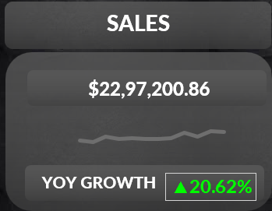
What is count of sales ?
Count of sales - $22,97,200.86
Yoy growth - 20.62%

Slide 4
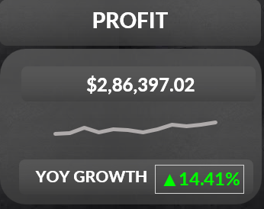
What is count of profit?
Count of profit - $2,86,397.02
YOY growth - 14.41%

Slide 5
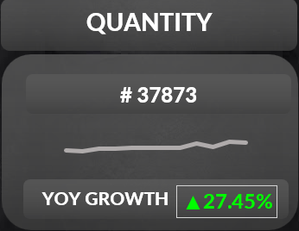
What is count of quantity?
Count of quantity – 37873
YOY growth - 27.45%

Slide 6
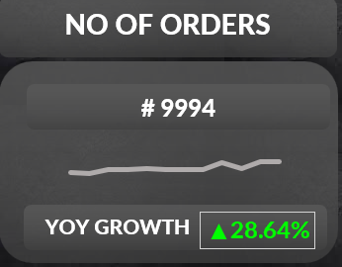
What is count of no of orders?
Count of orders – 9994
YOY growth – 28.64%

Slide 7
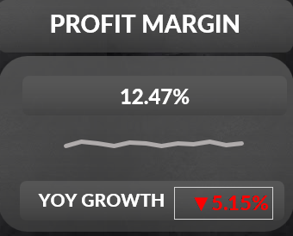
What count of profit margin?
Percentage of profit margin – 12.47%
YOY growth – 5.15%(decreasing)

Slide 8
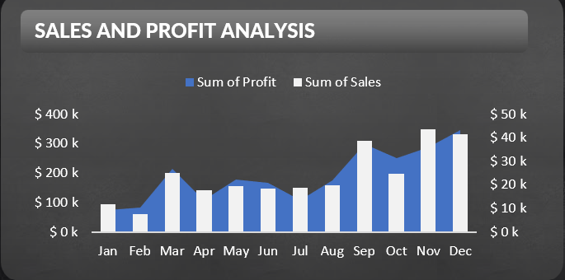
What is analysis of profit and sales?
In the month of November the sales is high and in the month of February it is low
In the month of December the profit is high and in the month of January it is low

Slide 9
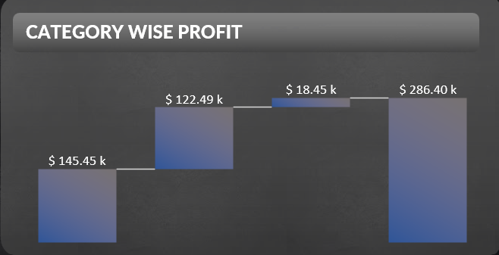
What is the profit according to category wise?
Category wise profit shown as below

Slide 10
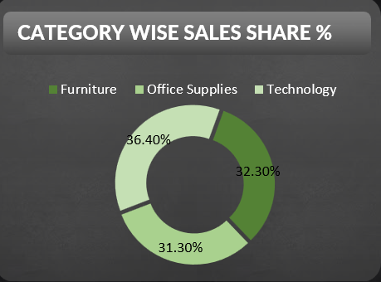
What is the share percentage according to category wise?
Furniture – 32.30%
Office supplies – 31.30%
Technology – 36.04%

Slide 11
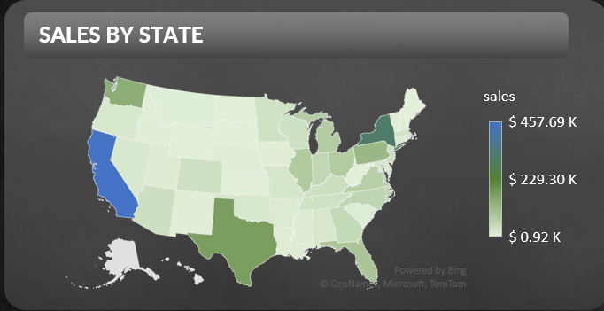
What is sales by state?
Sales by state as given below:

Slide 12
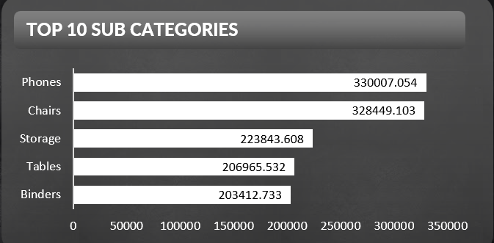
What is top 10 sub-categories?
Phones, chairs, storage are top 3

Slide 13
Interactive Dashboard

Slide 14
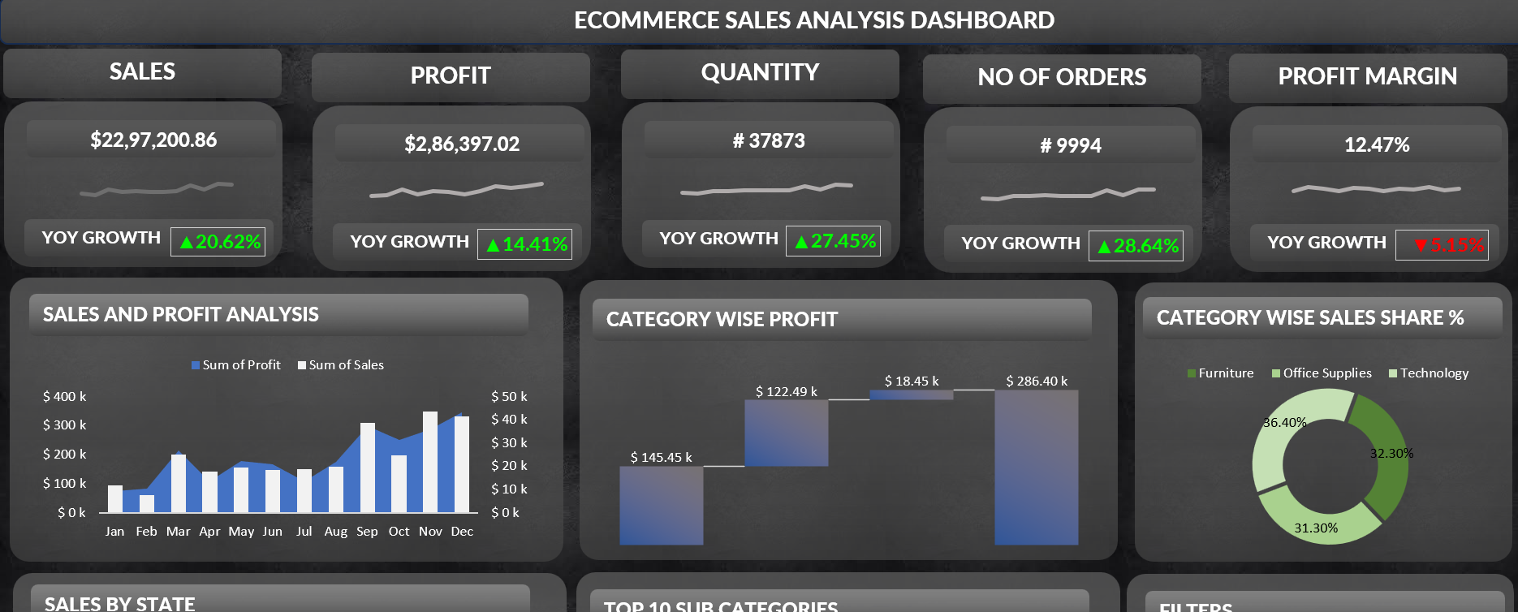

Slide 15
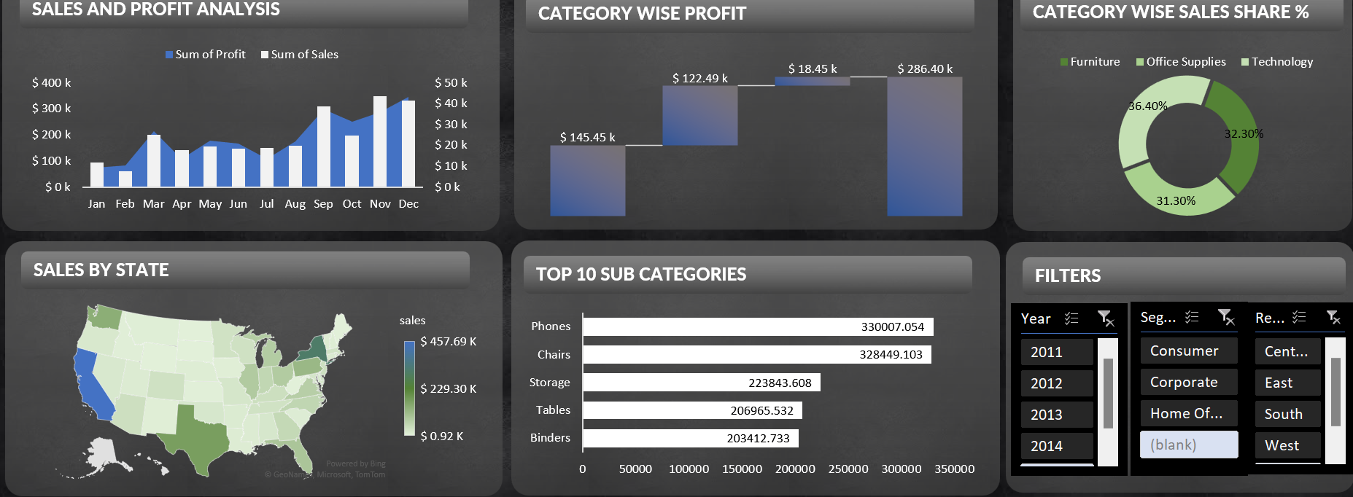

Slide 16
Thank you

